Slide 1

Analysis of Property Sales
Ryan Chung

Slide 2

Outline
Introduction
Business Problem
Data & Methods Used
Results & Conclusion
Final Thoughts

Slide 3

Project Introduction
Business Problem
A local real estate agency is looking to identify features of house listings that act as accurate predictors of their selling prices to take into consideration when purchasing and selling residential property.

Slide 4



For this project, the real estate agency provided a data set which was comprised of residential property listings with various features. Some of the features in the data set include housing aspects such as number of bedrooms, bathrooms, and floors.
Data Used
Notes:
Column Names and descriptions for Kings County Data Set
id - unique identified for a house // Date - house was sold //Price - is prediction target // bedroomsNumber - of Bedrooms/House // bathroomsNumber - of bathrooms/bedrooms
sqft_livingsquare - footage of the home // sqft_lotsquare - footage of the lot // floorsTotal - floors (levels) in house // waterfront - House which has a view to a waterfront
view - Has been viewed // condition - How good the condition is ( Overall ) // grade - overall grade given to the housing unit, based on King County grading system
sqft_above - square footage of house apart from basement // sqft_basement - square footage of the basement // yr_built - Built Year // yr_renovated - Year when house was renovated
zipcode – zip // lat - Latitude coordinate // long - Longitude coordinate // sqft_living15 - The square footage of interior housing living space for the nearest 15 neighbors
sqft_lot15 - The square footage of the land lots of the nearest 15 neighbors

Slide 5

Methods
Initial Steps
Final Model
Upon receiving the data set, it was cleaned and checked for null values.
After cleaning the data, basic visualizations were created for several housing features.
Three simple linear regression models were created based upon the insights from the basic visualizations.
After looking at various housings features and their impact on their selling prices, the decision to make a multiple linear regression was made.
The multiple regression model encompassed all housing features and was created using an iterative approach.
A train test split approach was utilized, features were scaled, and the model was then checked for multicollinearity along with its distribution of error terms.
Upon the completion of the finalized model, R2 values were compared and the RMSE was evaluated.
Several housing features were identified to be accurate predictors of a house’s selling price.

Slide 6
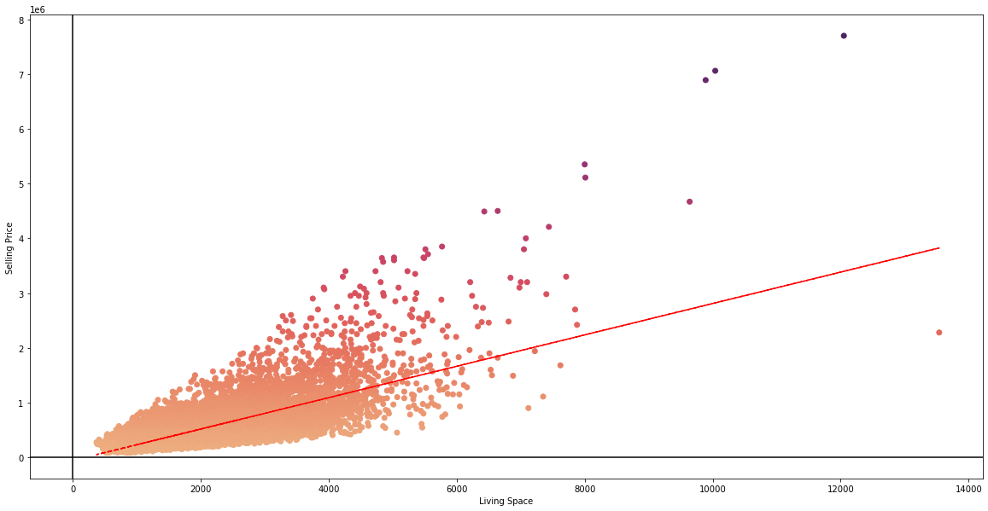
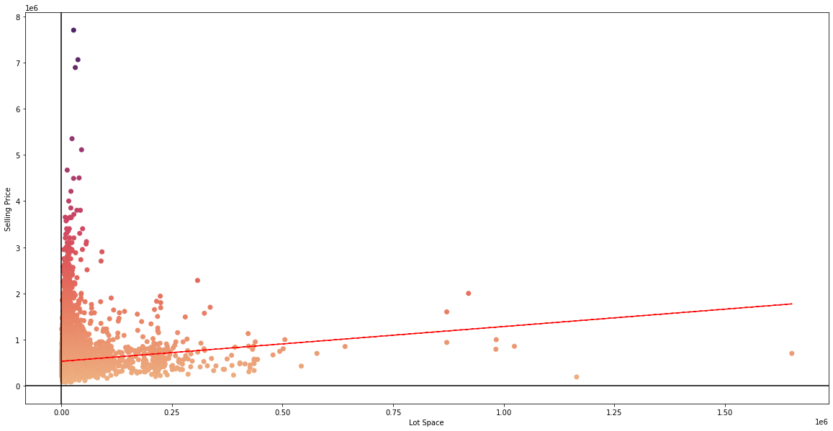
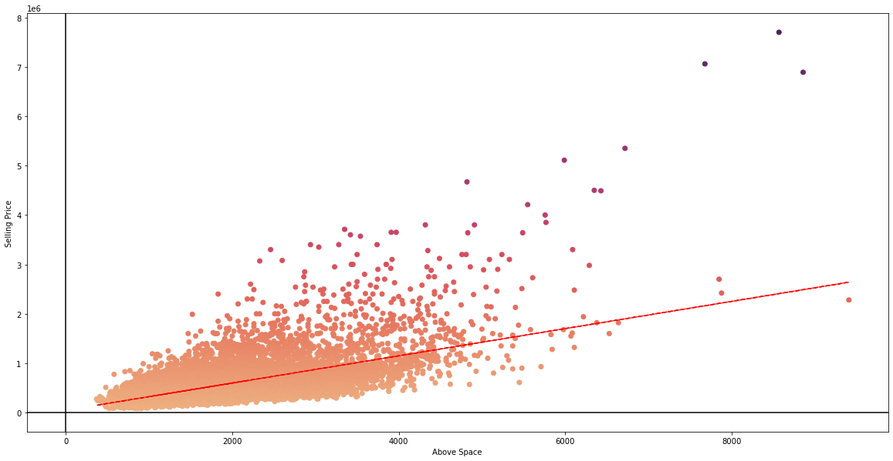
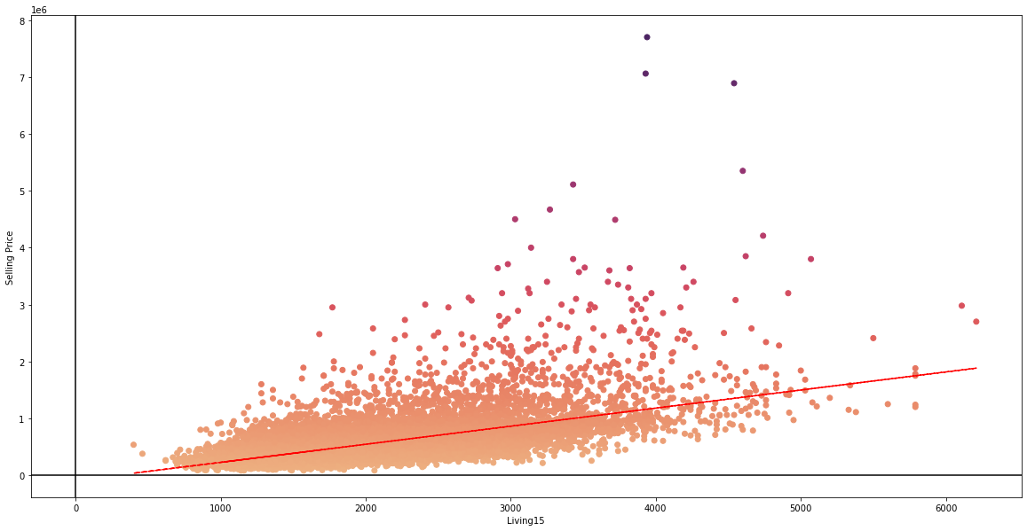
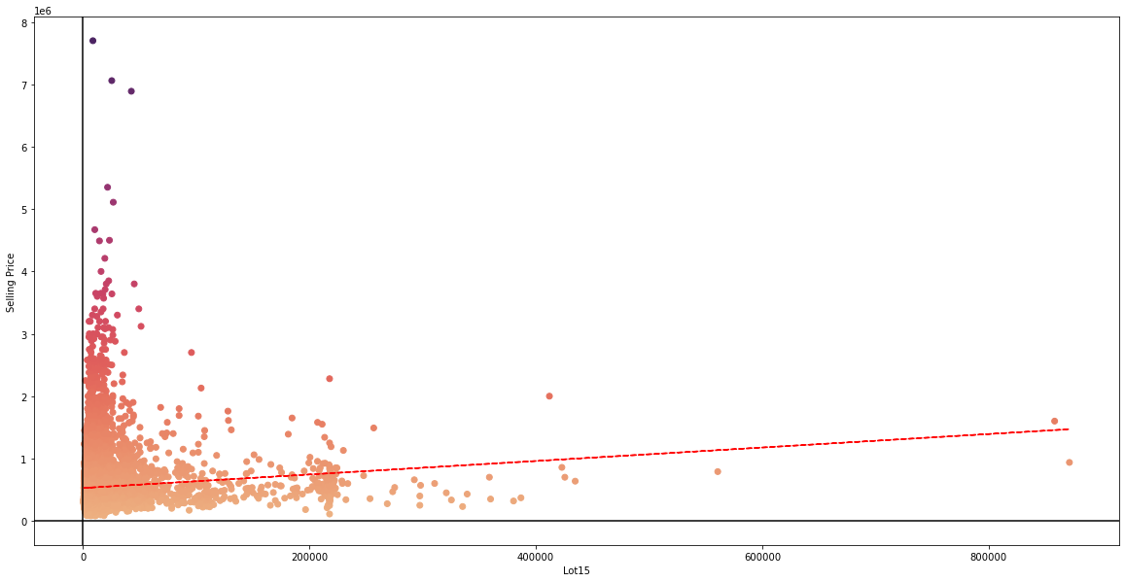
Initial Visualizations
Notes:
Visualizations from top left to bottom right:
Living Space v Price // Lot Space v Price // Above Space v Price // Living Space 15 v Price // Lot 15 Space v Price
From these basic visualizations, the housing features will need to be scaled and normalized for the creation of the model. (As seen in JYNB).

Slide 7
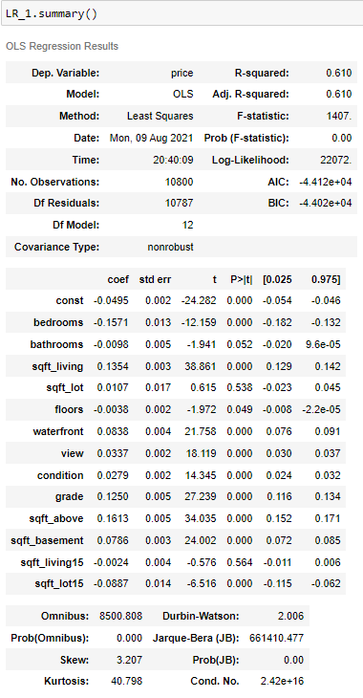
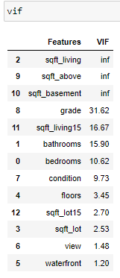
Initial MLR OLS Summary + VIF Values
Notes:
From the Initial OLS Summary we can see the R2 values is 0.610.
In order to check for multicollinearity of features within the model, the variance inflation factor was calculated for each feature. After calculating each VIF, the features with the highest VIF were removed from the initial model until all calculated VIFs in the model were less than 5. (As seen in JYNB).

Slide 8
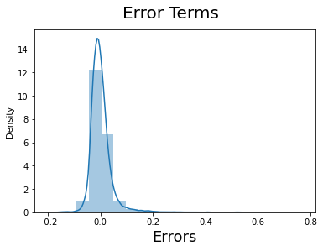
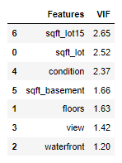
Final MLR OLS Summary + VIF Values
Notes:
In the creation of the final model, the error term distribution was checked and found to be normal. The final VIF values of each housing feature in the model are displayed above.

Slide 9
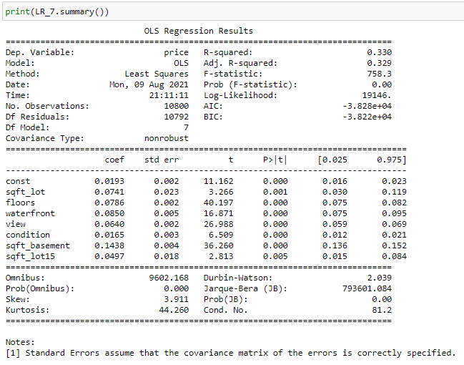
Final MLR OLS Summary
Notes:
After removing features with VIF values over 5, the OLS summary was checked once more. A new R2 value of 0.330 was found and each feature in the model had p values < 0.01.

Slide 10
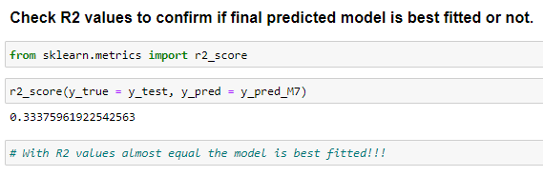
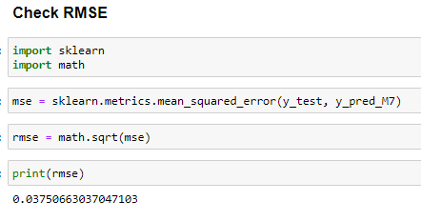
Confirmation of R2 Values and RMSE Value
Images from JYNB
When comparing the two computed R2 values, the final model was confirmed to be best fitted.
Using the sklearn library, the RMSE value was found to be 0.0375.
Notes:
With the R2 value of the trained model being 0.330 and the R2 value of the tested/predicted model being 0.333 we can confirm the final model is best fitted.
The RMSE value was found to be 0.037 which indicates the data is fairly concentrated on the model’s line of best fit.

Slide 11




Results & Conclusions
Data Cleaned + Visualized (EDA)
Initial Model Checked for Multicollinearity + Error Term Distribution
Reviewing the final multiple regression OLS summary, the features indicated to be accurate predictors of a house’s selling price include the following: Square footage of property’s lot, number of floors, waterfront, view, condition of property, square footage of basement, & square footage of nearest 15 neighbor’s lot.
Returning to the initial business problem, it can be said that the local real estate agency should look at these features of residential housing listings when purchasing and selling property.
R2 Values of Model Compared + RMSE Calculated
Features Identified as Accurate Predictors for Business Recommendations.

Slide 12
Thank You!

